Slide 1
Where a venom (or drug) could work. . .
Receptor Agonists / Antagonists
Reuptake Inhibitors
Neurotransmitters
K⁺
Na⁺
Ca⁺⁺

Slide 2
The first neuron was probably a chemo-receptor. . .
‘Taste’ is sensing a chemical in a liquid phase
‘Olfaction’ is sensing a chemical in a gas phase

Slide 3
A Cellular Understanding of Taste
We eat for our cells
What do cells need?
Well. . . What are cells doing?
  Amino Acids (to build proteins, enzymes)
  Carbohydrates (cellular energy)
  Some Basic Elements (salts, metals)
  Enzyme Co-factors (vitamins)

Slide 4
Obvious Biological Importance
What do we perceive as taste?
  Bitter, Sour, Salt, Sweet, and Umami
  . . . And then we ‘feel’
Where’s FAT in all this?
Approach vs. Avoidance
  Do you think these two will be equal?
  Is this learned?

Slide 5
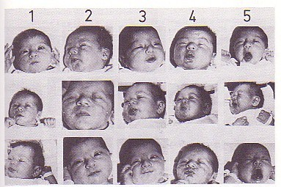
Evidence That Taste Is Innate
Resting
dH2O
Sweet
Sour
Bitter
Examples of the characteristic facial expressive features in response to gustatory stimulation (gustofacial reflex) in the perinatal human infant (Steiner 1987).

Slide 6
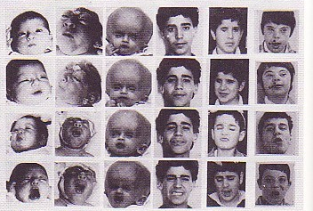
Reflex is Controlled by Brainstem Structures
Neonates
Adolescents
Resting face
Sweet
Sour
Bitter
Normal
An-
encephalic
Hydro-
anencephalic
Normal
Blind
Learning
Disabled
Examples of the gustofacial reflex in normal and abnormal perinatal infants and in normal, blind, and severely learning-disabled adolescents (Steiner 1987).

Slide 7
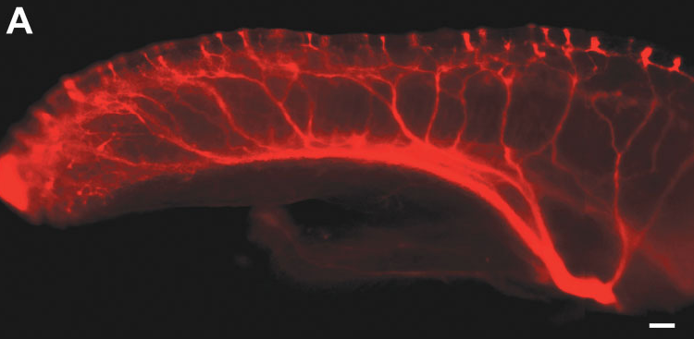
2D Receptor Arrays
Rat’s tongue viewed from the side. Lopez & Krimm, 2006

Slide 8
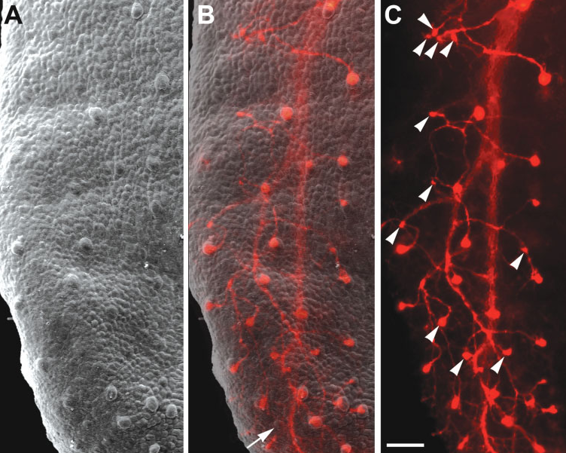
Looking down on a rat’s tongue. Lopez & Krimm, 2006

Slide 9
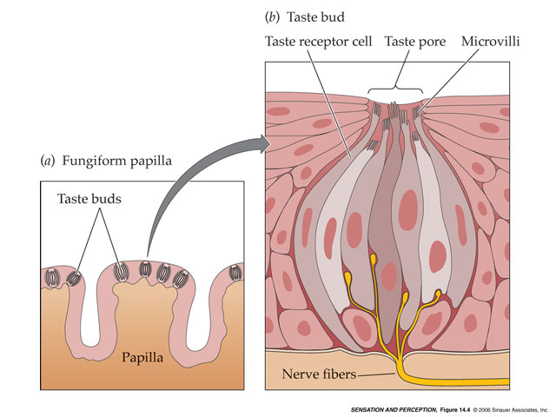
Taste Bud
Structure
Important Features:
Taste Pore
Microvilli
Tight Junctions
Nerve Fibers to Brain

Slide 10
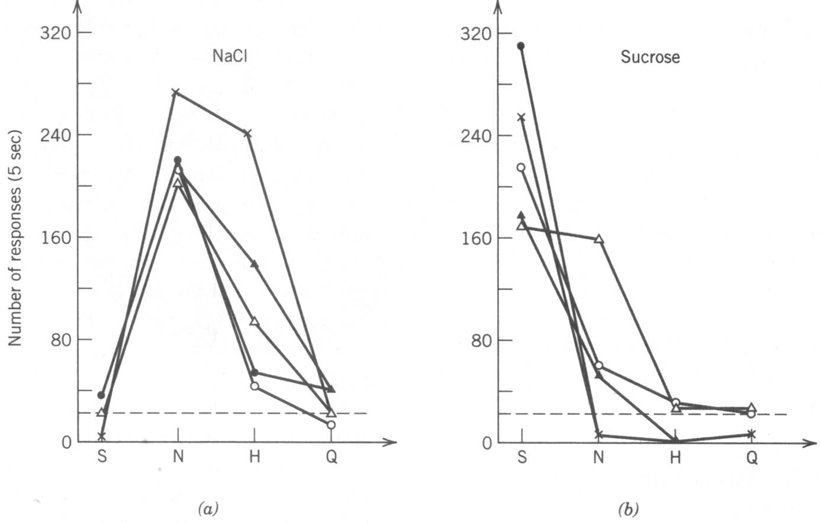
‘Labeled-Line’ receptors for Taste

Slide 11
Overlap in the distribution of receptors for the 5 basic tastes (however, thresholds for each differ)
Bitter Salty Sweet Umami Sour

Slide 12
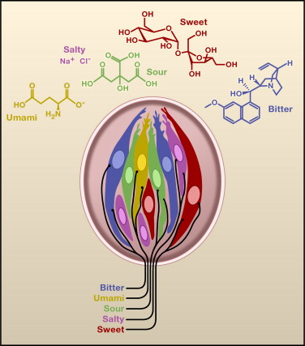
Individual taste buds typically contain receptor cells for each class of taste

Slide 13
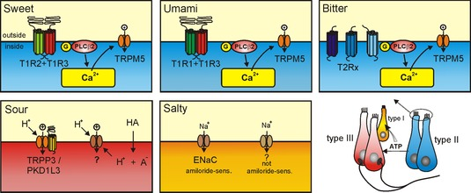
Transduction: 2 of the ‘basic tastes’ rely on ‘second messenger’ systems, as does Umami

Slide 14
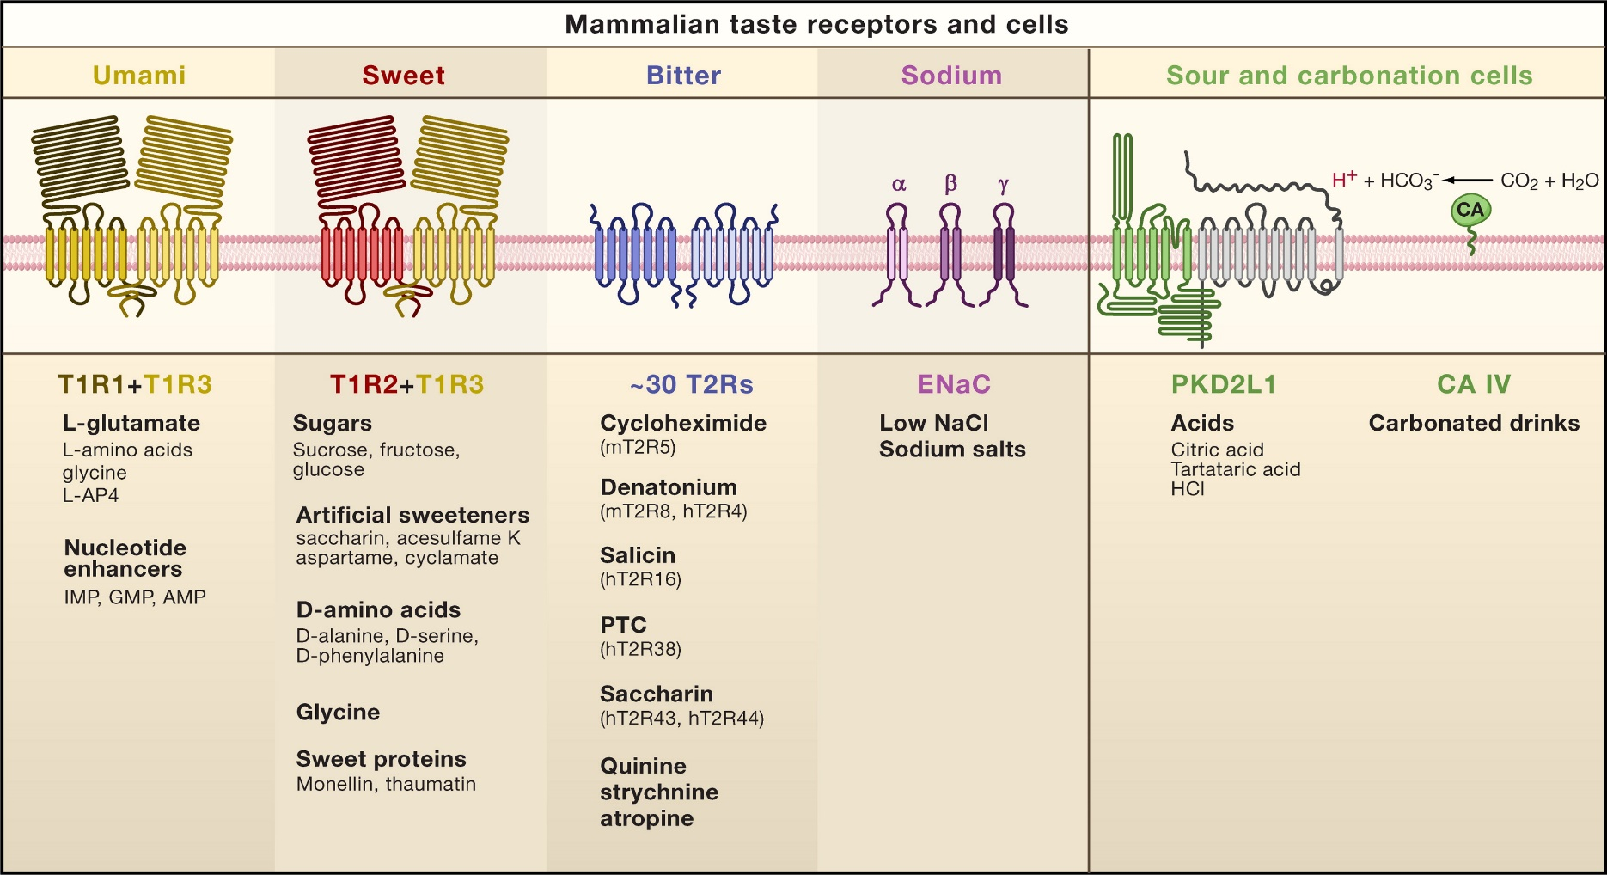
Transduction: 2 of the basic tastes rely on ‘second messenger’ systems, as does Umami

Slide 15
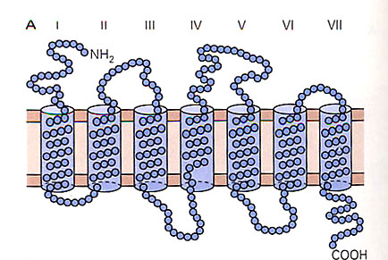
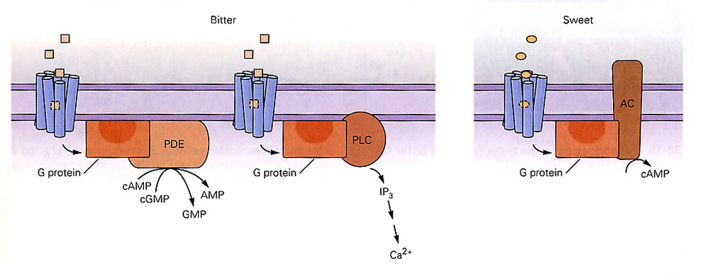
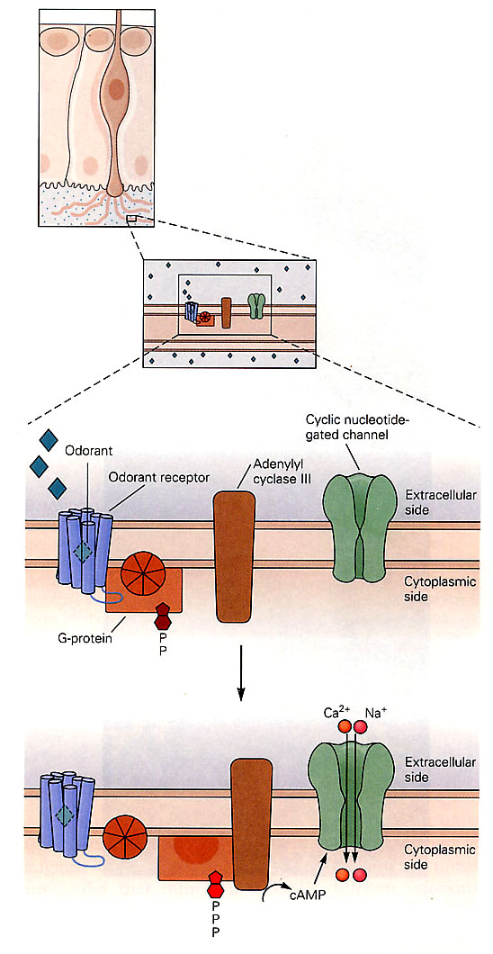
2nd Messenger Systems:
G-Protein Coupled
Receptors
The end result is similar to ‘1st Messenger’ systems

Slide 16
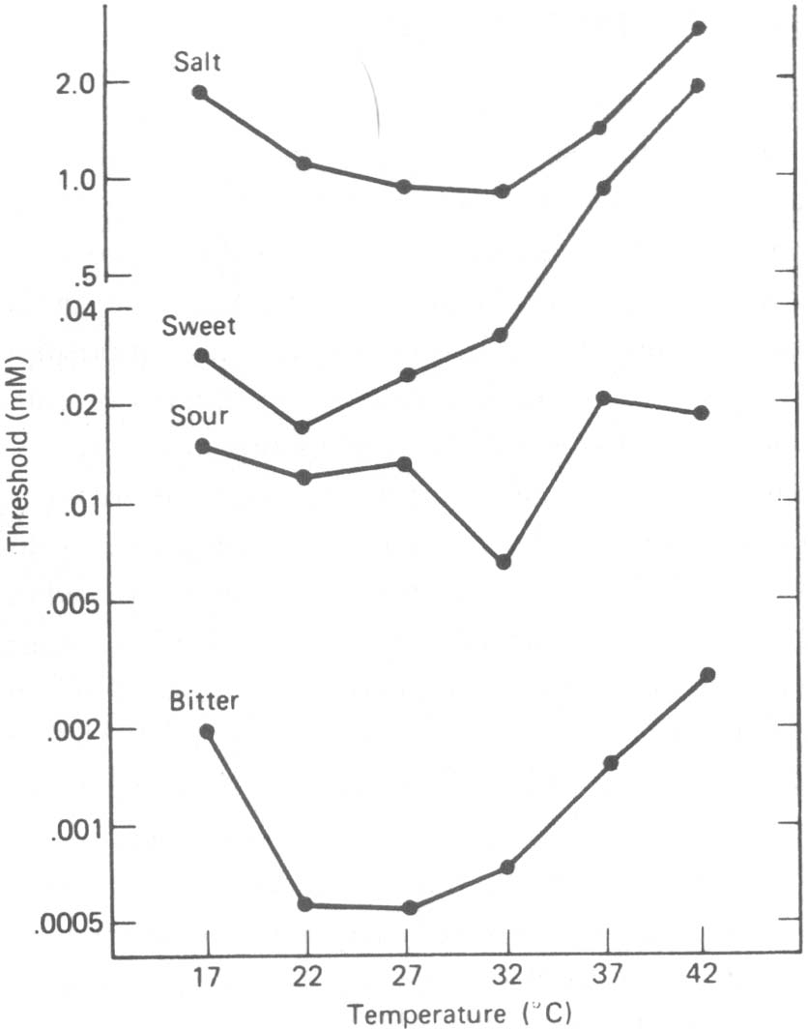
Effect of Temperature on Thresholds
The lower the threshold, the greater the perceived taste or sensitivity.
Important features:
  Sweet Range
  Sour sensitivity
  Bitter sensitivity

Slide 17
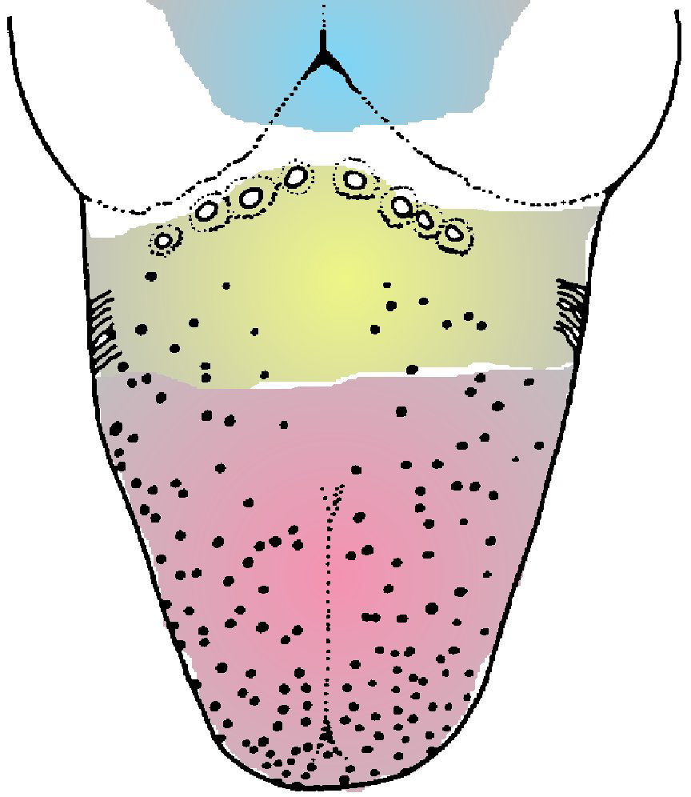
Regions of the tongue are innervated by specific sensory taste nerves.
Vagus Nerve
Glossopharyngeal
Nerve
Chorda Tympani Nerve (something familiar here. . .)

Slide 18
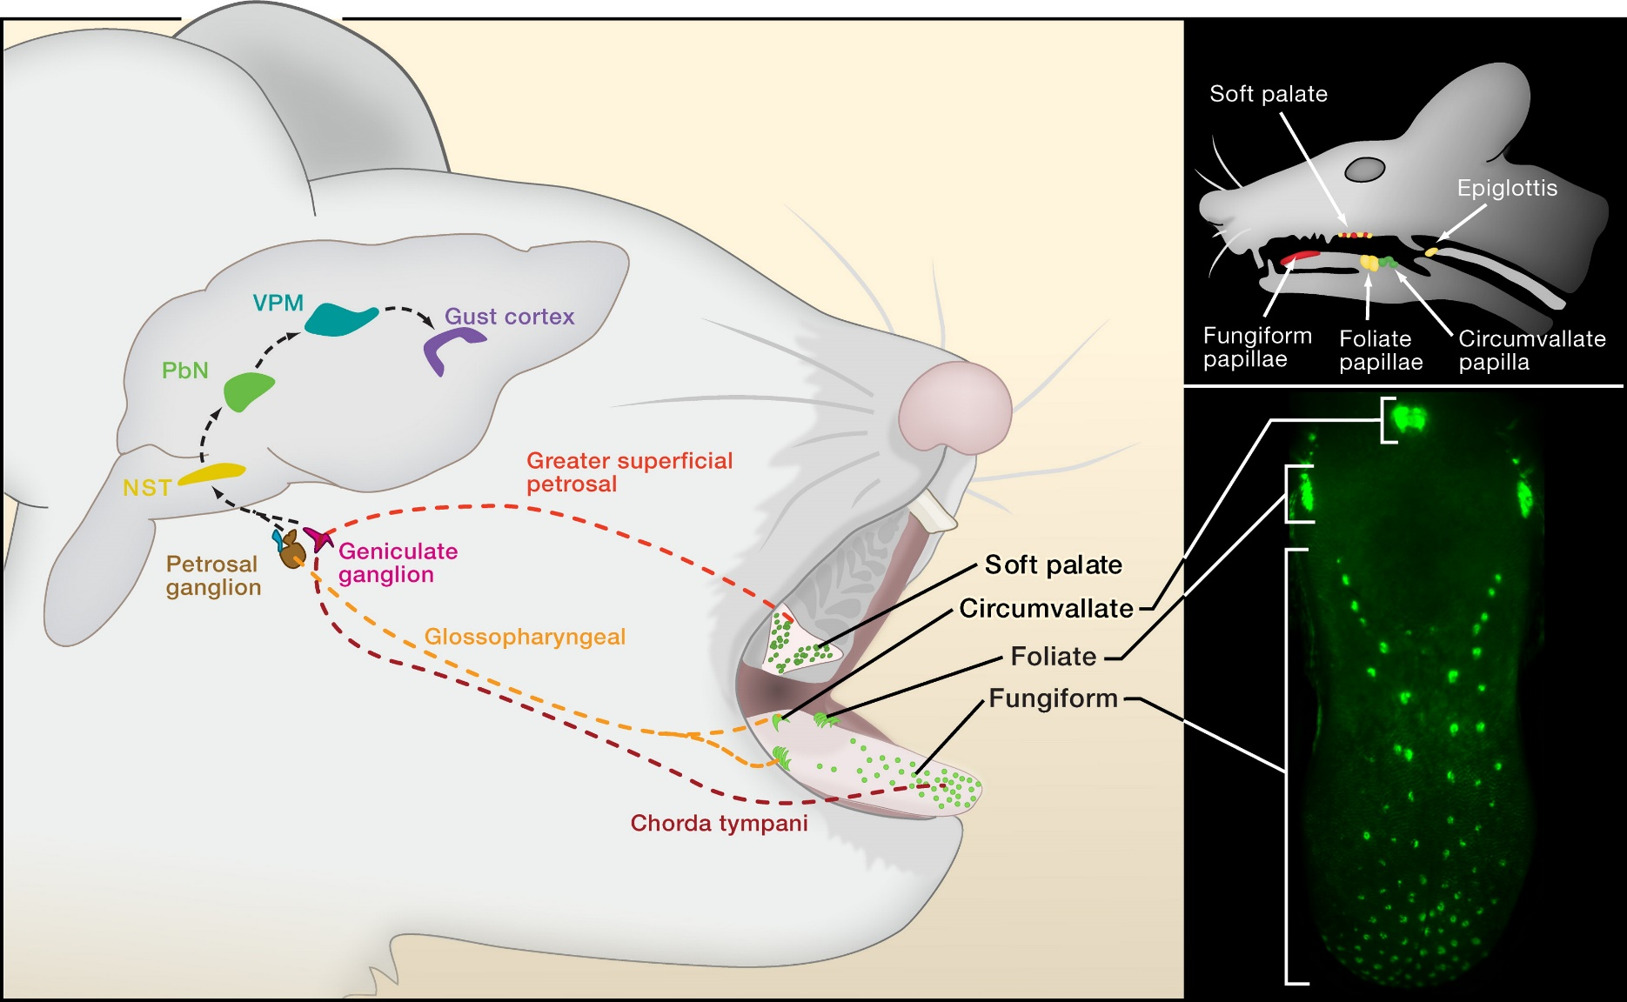
Neural Pathways
Note: No Left/Right Crossing

Slide 19
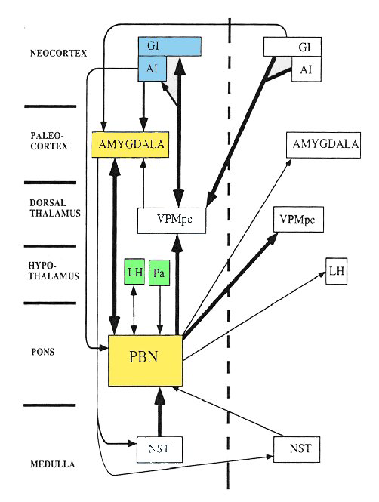
Brain regions receiving taste information
Cortex
Limbic
1. Primary Gustatory Cortex - Perception of taste quality (bitter, sour, salty, sweet, umami)
Diencephalon
2. AMYGDALA
Conditioned Taste Aversions
Hindbrain
3. Hypothalamus - Hunger and satiety

Slide 20
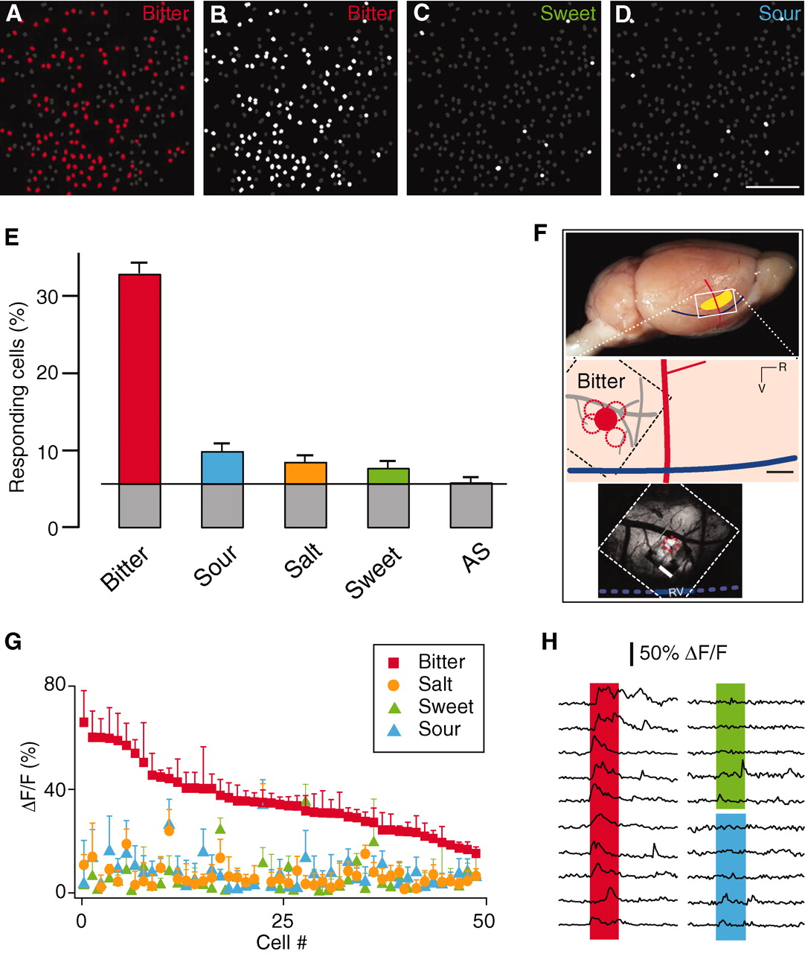
Primary Gustatory Cortex: Gustotopic Mapping
1:1
Cortical Field Sensitive to Bitter
Chen et al. 2011

Slide 21
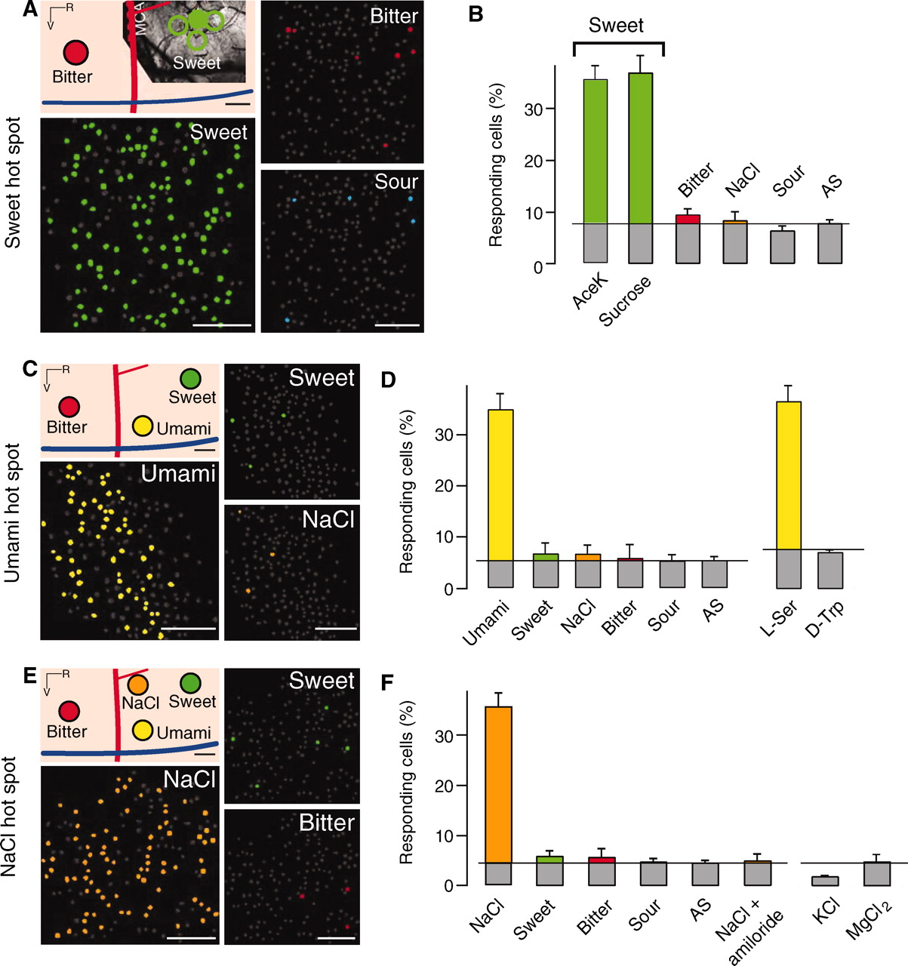

Slide 22
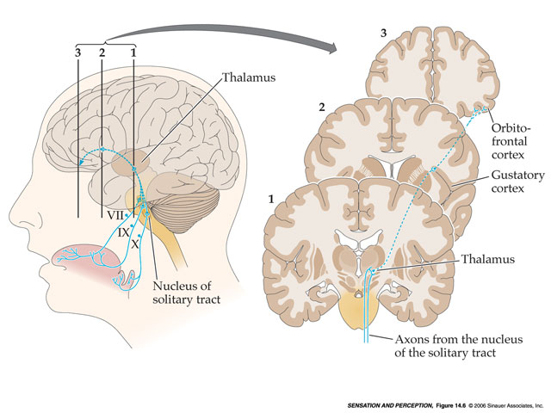
Neural Pathways: Orbitofrontal Cortex
Many:1
Note: No Left/Right Crossing

Slide 23
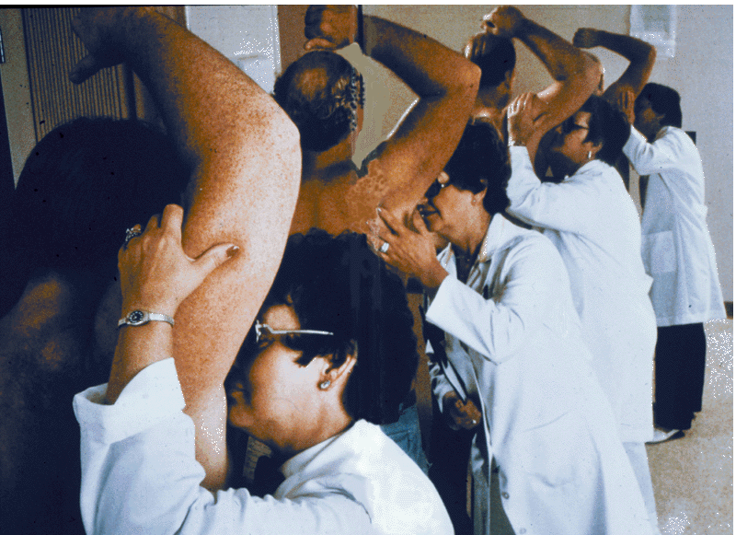
Compared to Taste, Olfaction seems to be mostly learned. . .
National Geographic, 1985

Slide 24
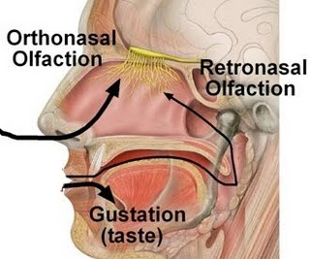
Olfactory Stimuli
Must be volatile
  Think of things that have taste but no smell
  . . . and vice versa
Similar to Taste in Function
  Approach/Avoidance – but LEARNED
  Retronasal Olfaction
  Additional ‘Social’ Role (pheromones)

Slide 25
Three ‘Olfactory’ Systems
The Main Olfactory System
Main Olfactory Bulb
What we think of as ‘smell’
The Vomeronasal System
Accessory Olfactory Bulb
Pheromonal Signals

Slide 26
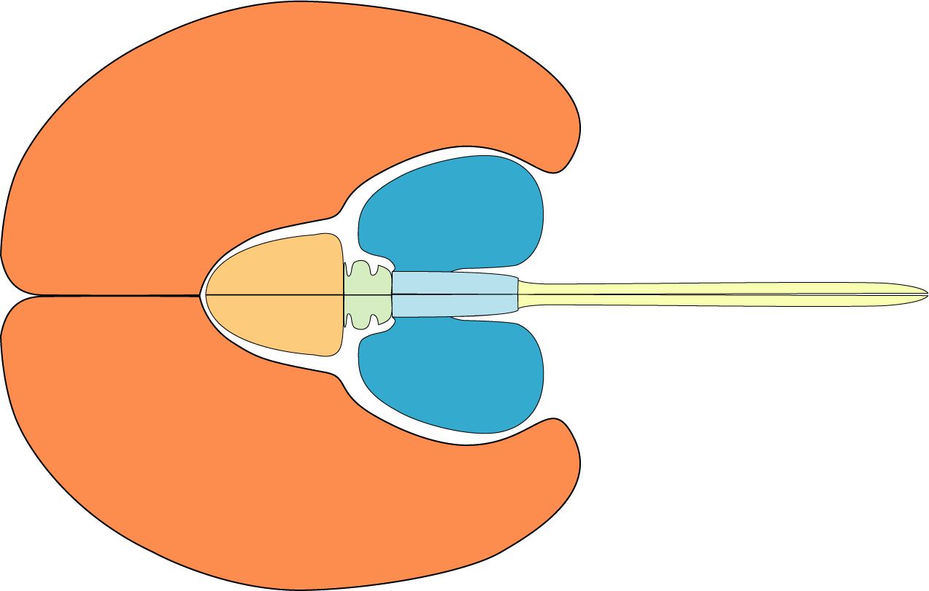

Slide 27
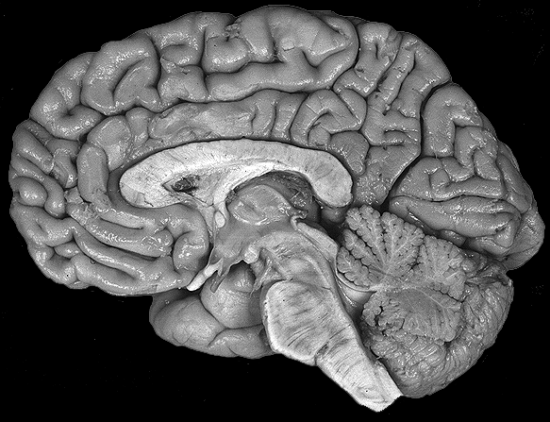
Mid-saggital View in Human
University of Washington. 1997.

Slide 28
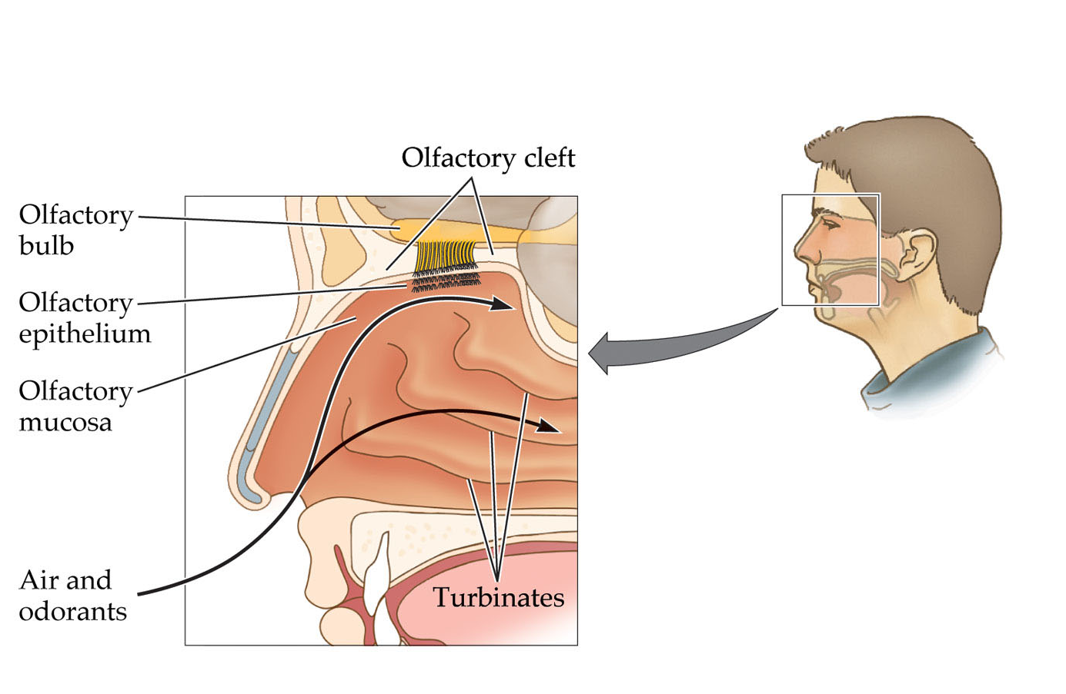
Olfactory Receptors and Some
Neurons in the Bulb also Regenerate
Some Drawbacks in Design

Slide 29
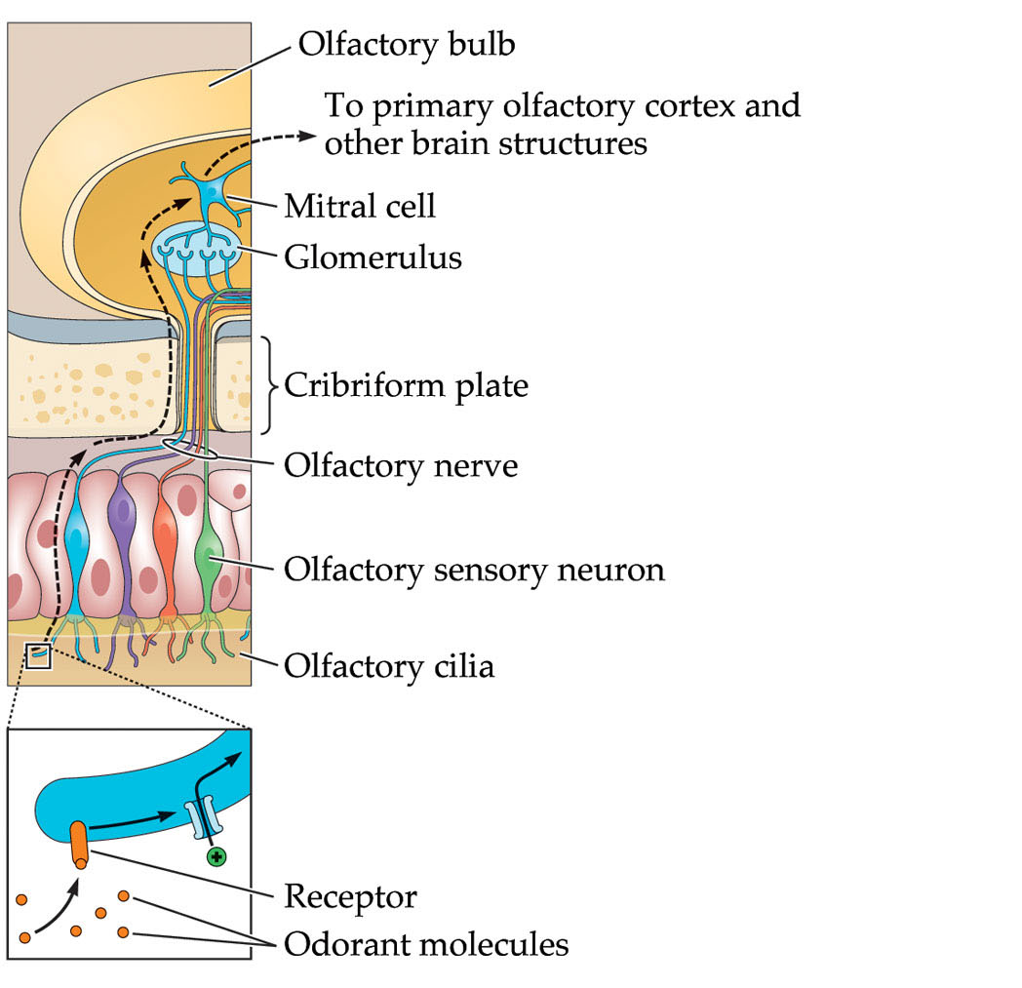

Slide 30
Olfactory Receptors
Are G-Protein Coupled
Receptors

Slide 31
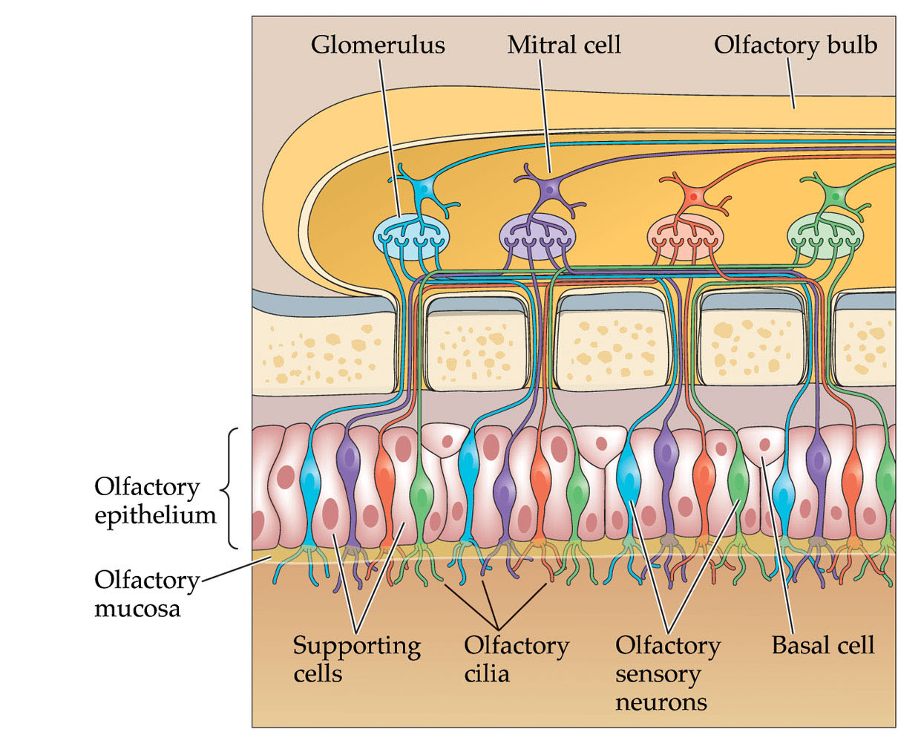
Model for olfactory coding

Slide 32
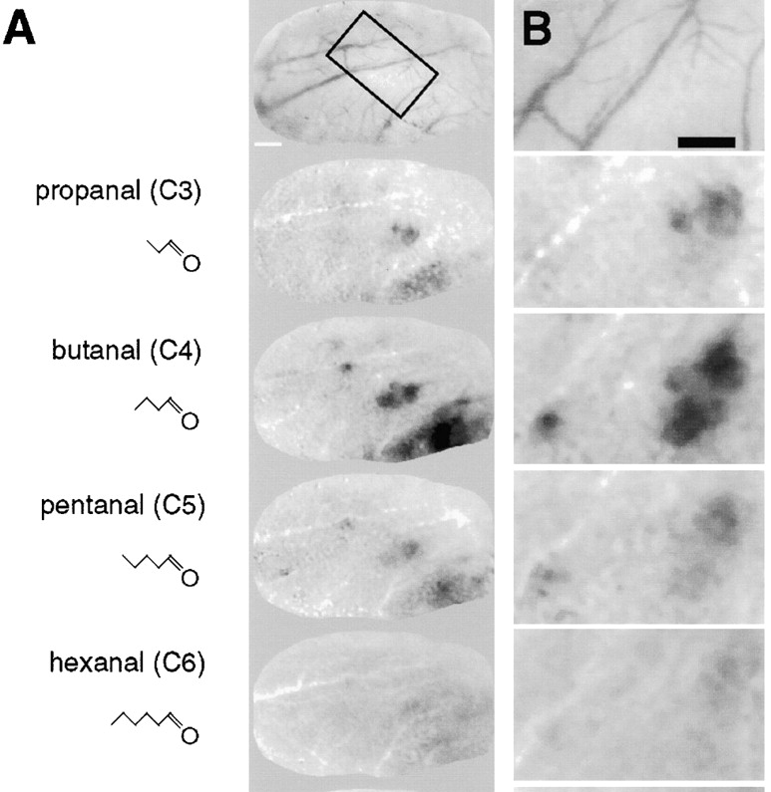
  Optical Imaging of Odorant Representations in the Mammalian Olfactory Bulb
Odorants with similar molecular structures activate similar sets of glomeruli

Slide 33
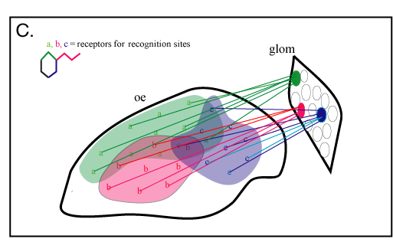
Relationships Among Response Patterns and Receptor Distributions
Marchand et al., 2003

Slide 34
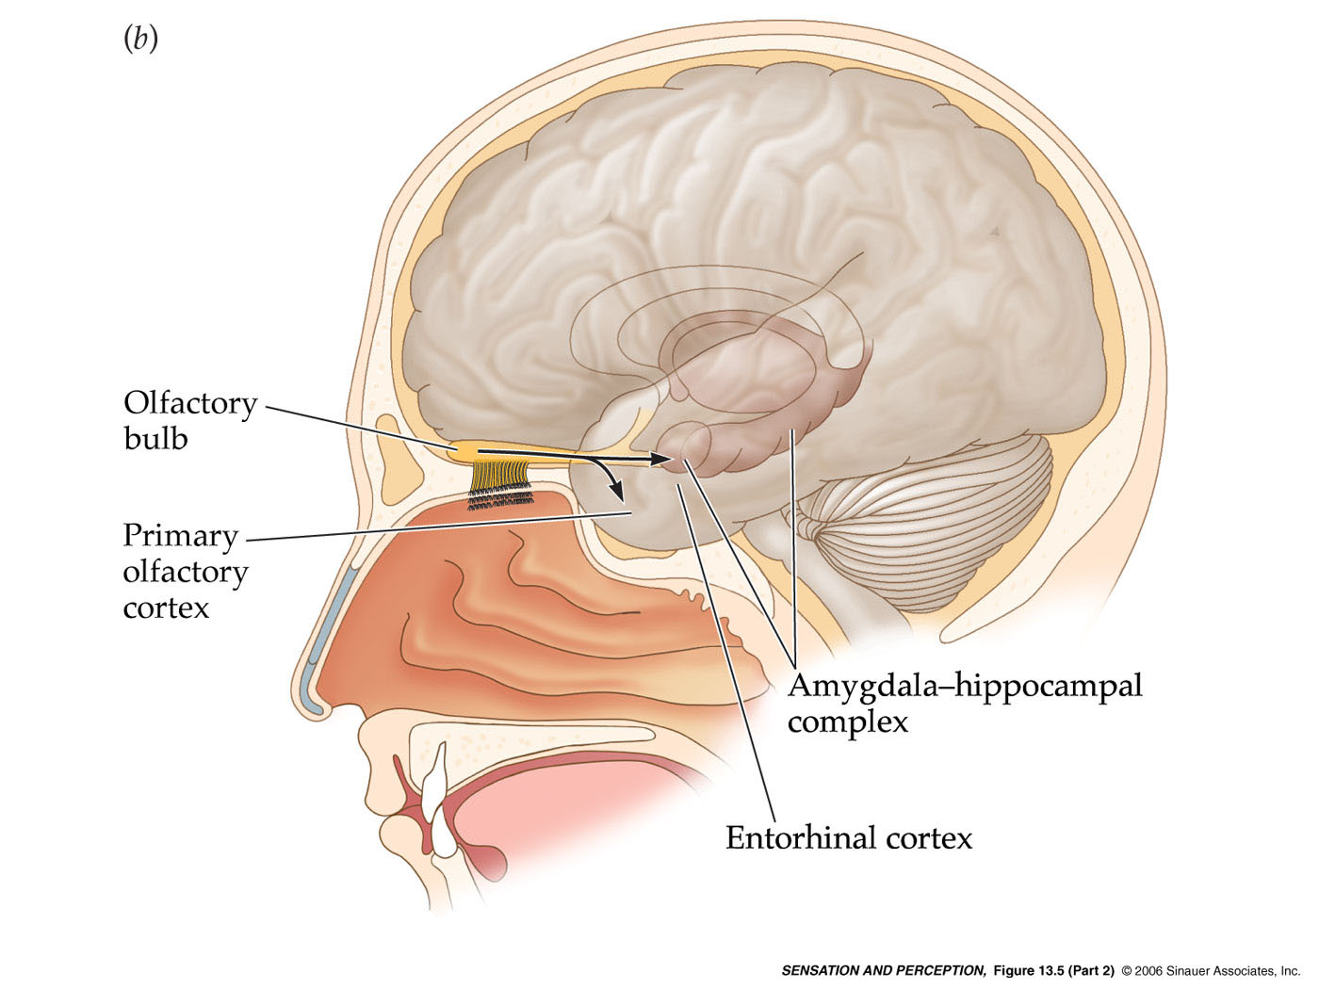

Slide 35
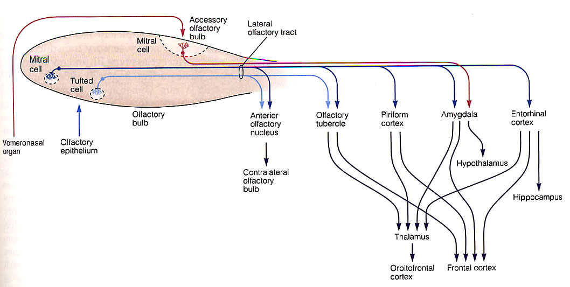
Projections of the Main Olfactory System

Slide 36
Projections of the Accessory Olfactory System

Slide 37
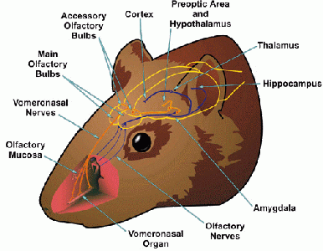
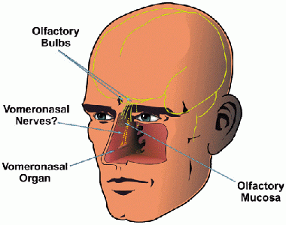
The Accessory Olfactory System
Pheromones (may be volatile or soluble)
Role in mammalian social behavior, endocrine function
The Vomeronasal organ - Accessory Olfactory Bulb
Primary output of AOS to Amygdala, Hypothalamus
Do humans have a VNO?

Slide 38
Pheromones
Used by most mammals, many insects to communicate:
  Sex (and reproductive status)
  Lineage
  Individuality
Modest positive evidence for a role in humans
  McClintock Effect – which is not a behavioral effect
Humans use Visual and Auditory cues to signal SLI
  Emphasis on the head and face
  Skin, hair, eyes, other facial features, voice
The reduced importance of pheromonal signaling in humans has implications for understanding our behavior
  Why sex is not a strictly ‘reproductive’ behavior in humans
  Why sexual attraction in humans is complex
  Why there are ‘races’ of humans, and what ‘race’ means

